Slide 1

FSDS_Sep_2022
iNeuron AI – Manu Madhav manumadhav@gmail.com

Slide 2
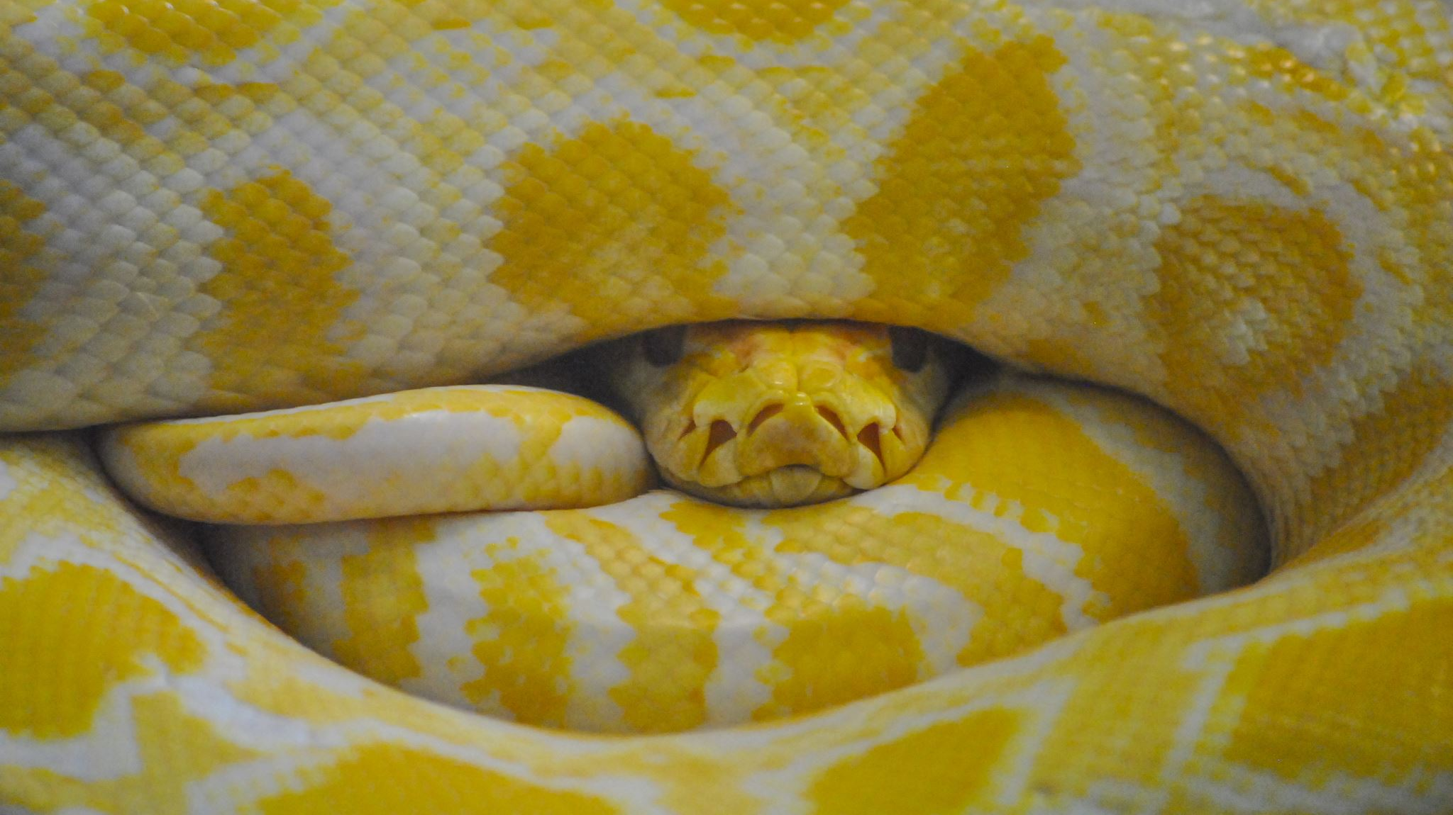
Basics of Python

Slide 3
Assignment 1
Find out all the types of error that we have encountered in our lecture and why? Also include the examples.
Take input A and B and print their sum, mul, div, square of the nos.
How many reserve keywords are there in python and why we should not use them as a variable name.
Create email ids with the user inputs. in the following format - lastname.firstname@gmail.com
Try to print the following lines -
Hi I'm Sunny
My address is 22\3
I earn 20$ daily.
Take user input (name, address, date of birth etc) to fill a form for your college and print their email IDs
Convert the following -
"22.4" into integer
"22" into complex no.

Slide 4
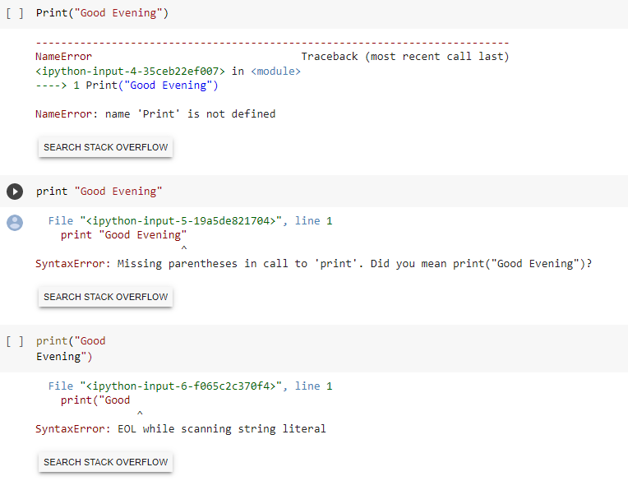
Assignment 1 – Que 1
Find out all the types of error that we have encountered in our lecture and why? Also include the examples.
As Python is case sensitive, function for print shall be called as “print()” and any other spelling shall lead to Traceback
“print()” : python 3 print statement syntax is with brackets. Traceback because brackets missing.
“print()” : typically expected to closed expression in a single line. For multiple line with in print statement “”” – three quotes to be provided at starting and ending

Slide 5
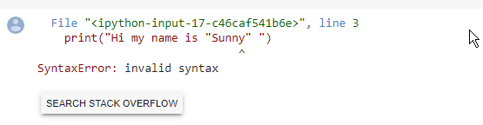
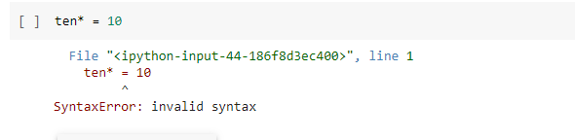
Assignment 1 – Que 1
print() function expects one set of quote for printing unless it is separated by comma or plus. Here system couldn't identify print area. Use \” Sunny \” or use of ‘ “Sunny “ ‘ or “ ‘Sunny ‘ “ to avoid this error
Variable names should not contain any special characters like ^ % $ ! @ # ^ & * ( )

Slide 6
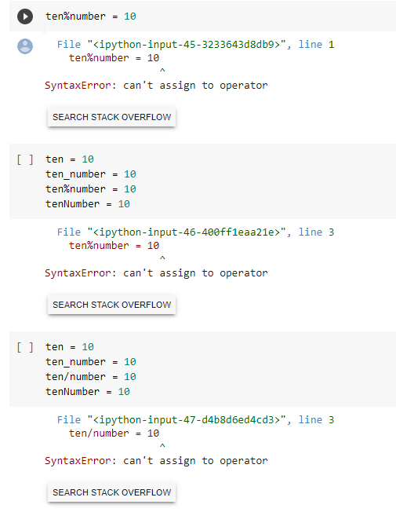
Assignment 1 – Que 1
Variable names should not contain any special characters like ^ % $ ! @ # ^ & * ( )
Variable names should not contain any special characters like ^ % $ ! @ # ^ & * ( )
Since Python is iterative language, it stop compiling where error occurred
Variable names should not contain any special characters like ^ % $ ! @ # ^ & * ( )
Since Python is iterative language, it stop compiling where error occurred

Slide 7
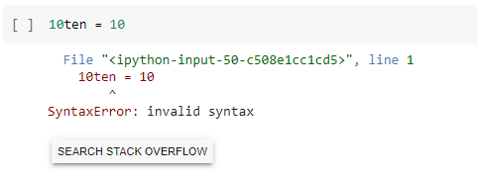
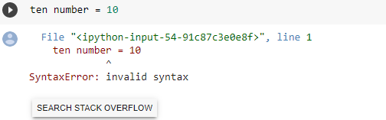
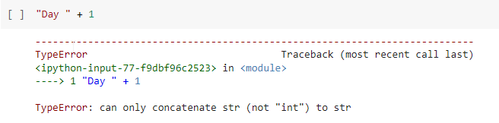
Assignment 1 – Que 1
Variable names can contain numbers but you can't start with numbers
Variable contain space. It shall be similar to ten_number =10
Summation of String and int is not possible

Slide 8
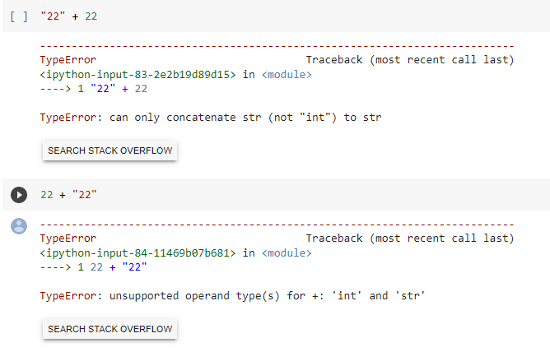
Assignment 1 – Que 1
Concatenation of String and int is not possible. Since String is first element, Python expectation of joining the second element by concatenation.
Summation of int and string is not possible.
Since Int is first element, Python expectation of joining the second element by summation.

Slide 9
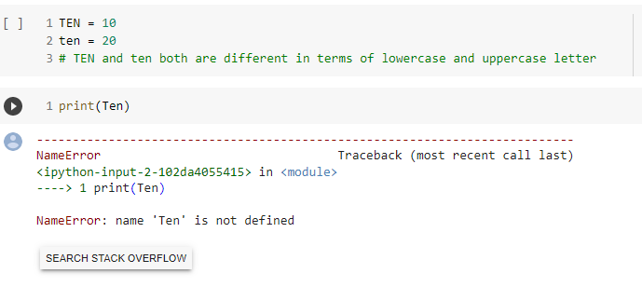
Assignment 1 – Que 1
Variable assignment is case sensitive. TEN, ten and Ten are different variable and error occurred since TEN and ten are defined and Ten is not defined

Slide 10
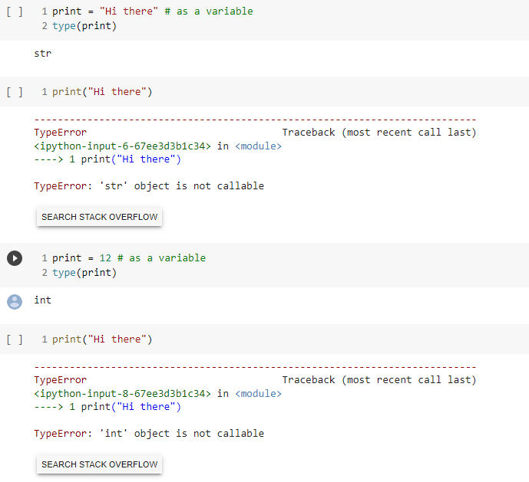
Assignment 1 – Que 1
print() is a system function and a reserved word. Though python allows assign the reserve words with a value, it shouldn’t be done. In this case print() was not able to execute since another value was assigned on it and its type is changed.

Slide 11
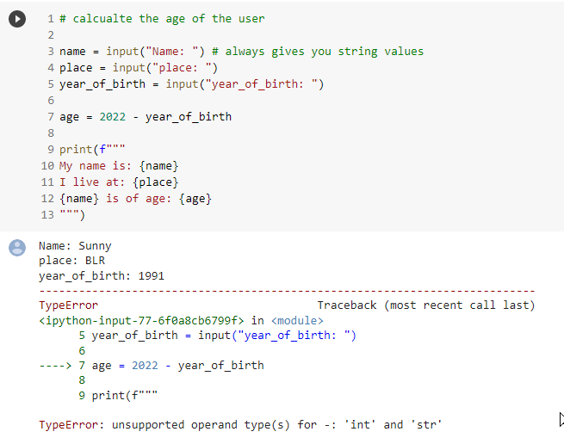
Assignment 1 – Que 1
Input command assigned the user input value as string and Traceback occurred since we tried to subtract string from 2022(int).
Solun: convert user input into int

Slide 12
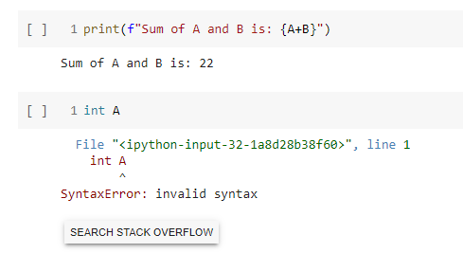
Assignment 1 – Que 1
For type convert use int as function like int(A)
( A is already int in this case )

Slide 13
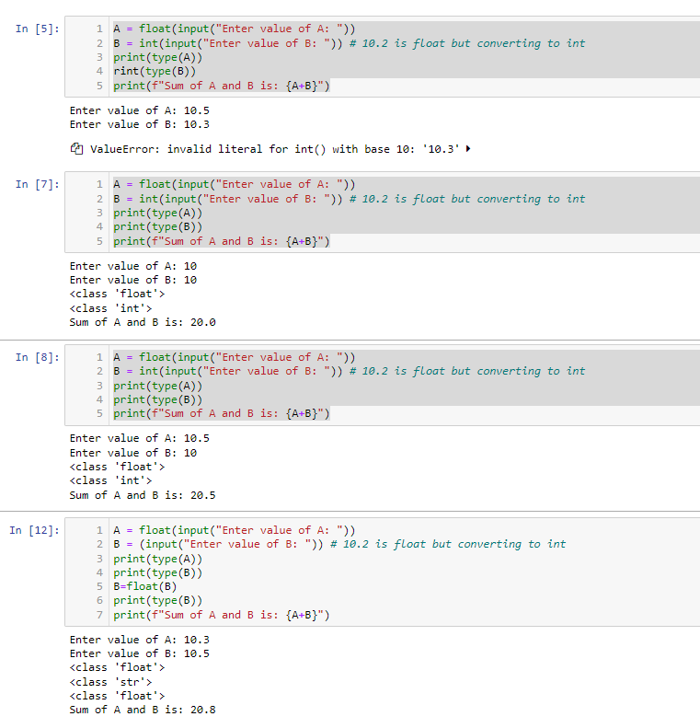

Assignment 1 – Que 1
Variable B is expected to be int and error occurs when user enters float data

Slide 14
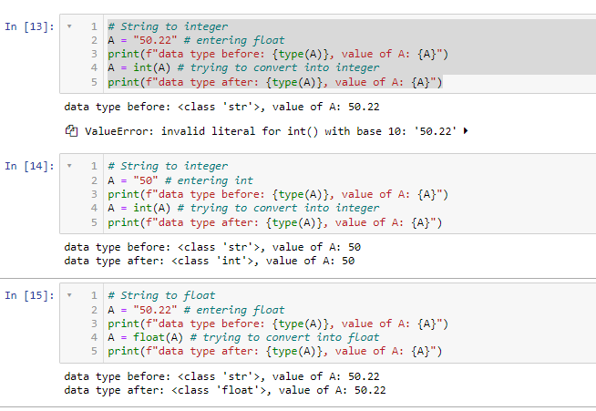
Assignment 1 – Que 1
String to int conversion is not possible since entered value is float

Slide 15
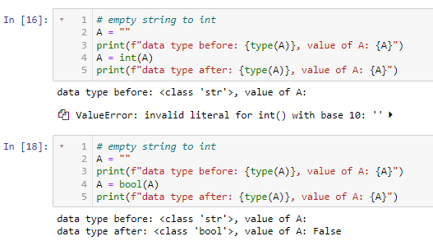
Assignment 1 – Que 1
Blank to int conversion failed

Slide 16
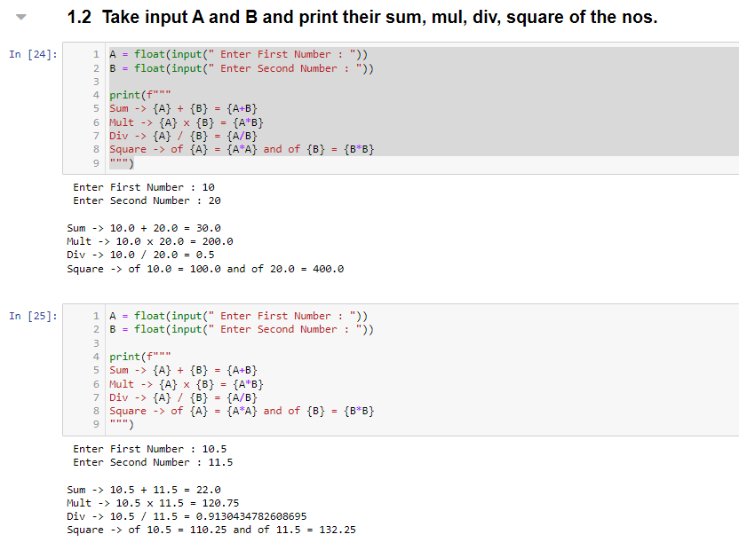
Assignment 1 – Que 2
Take input A and B and print their sum, mul, div, square of the nos.

Slide 17
Assignment 1 – Que 3
How many reserve keywords are there in python and why we should not use them as a variable name.
False | def | if | raise
None | del | import | return
True | elif | in | try
and | else | is | while
as | except | lambda | with
assert | finally | nonlocal | yield
break | for | not
class | form | or
continue | global | pass

Slide 18
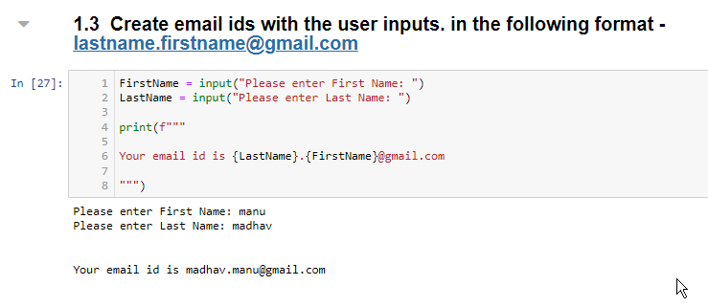
Assignment 1 – Que 4
Create email ids with the user inputs. in the following format - lastname.firstname@gmail.com

Slide 19
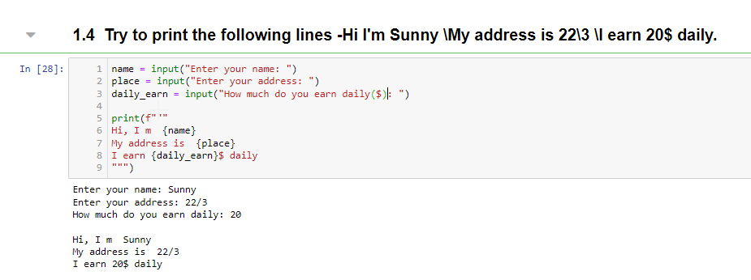
Assignment 1 – Que 5
Try to print the following lines -
Hi I'm Sunny
My address is 22\3
I earn 20$ daily.

Slide 20
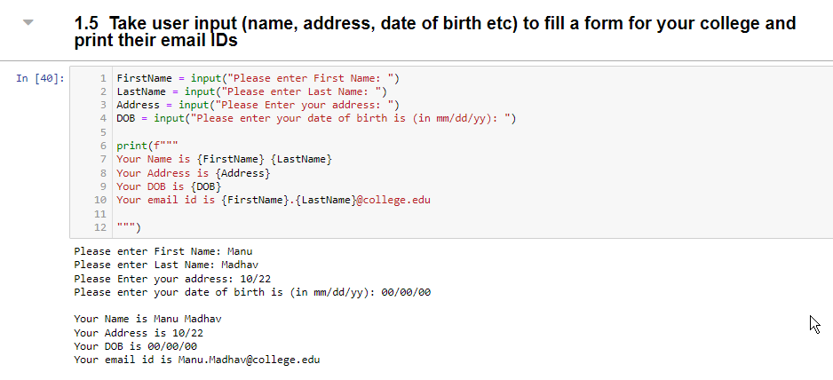
Assignment 1 – Que 6
Take user input (name, address, date of birth etc) to fill a form for your college and print their email IDs

Slide 21
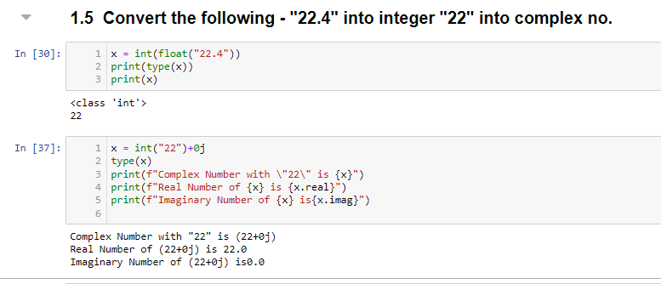
Assignment 1 – Que 7
Convert the following -
"22.4" into integer
"22" into complex no.

